Slide 1
Fleet Management System

Slide 2
VISION :
Our aim is to solve all types of problems faced by transport providers from different walks of life and achieve compliance
MISSION :
With an array of vital fleet management solutions, we provide Transport Managers with a helping hand while they face issues managing small fleets with 2-3 vehicles to large fleets with hundreds of vehicles

Slide 3
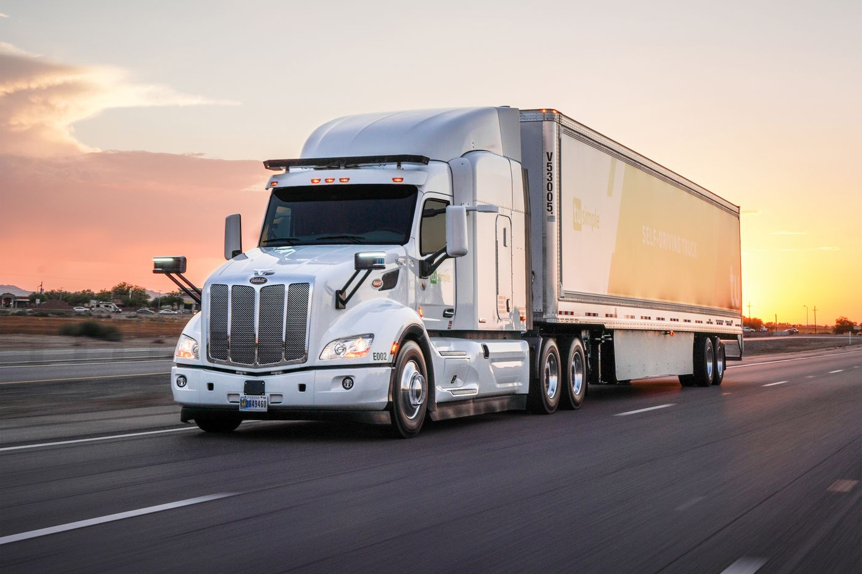
PROBLEM :
Route Optimization
Vehicle Tracking
Driver Behavior
Making sure all assets are fully utilized
Finding specific fleet information quickly

Slide 4
SOLUTION :
Track all Vehicles in your fleet in real-time
Monitor driver behavior
Optimal Utilization of Vehicles
Generate Real-Time Reports
Establish Geo-Fence

Slide 5
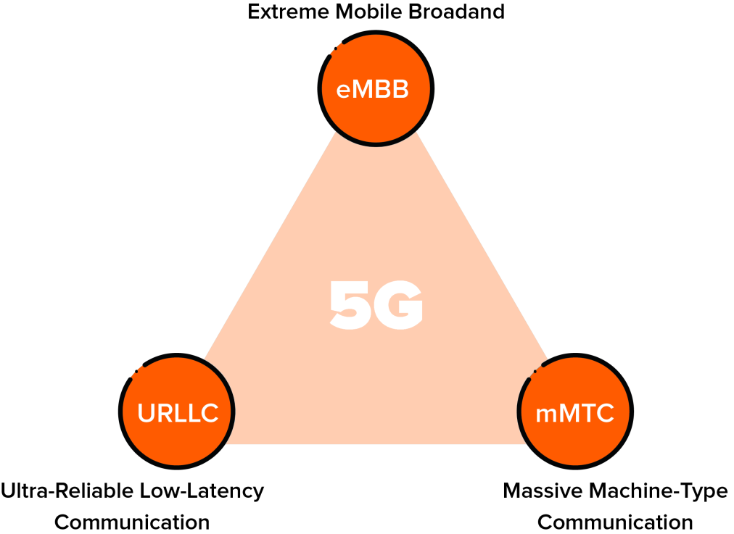
WHY NOW ?
Estimated Vehicle Tracking Market Growth by 2021 - 14.0% more than 2015-2020 due to:
Rising demand for fleet telematics in transportation & logistics industries.
The growing trend of car leasing & rental-services
Need for operational efficiency by fleet owners
The technological advancements in the automotive sector has improved the reliability & accuracy for navigation. The capabilities of 5G (low latency, enhanced speed & high capacity) are bound to improve the performance and demand of Vehicle Tracking Devices.

Slide 6
VEHICLE TRACKING MARKET ANALYSIS
Vehicle Tracking Market is categorized on the basis of its type [Active or Passive]
While the European market has reached a mature phase, the UAE market is expected to show a rapid rise in automotive sales.
This increase demand is expected as the need for real time data monitoring & reporting is rising rapidly.
Global Market Growth Projection by Type
2017
2025
ACTIVE
PASSIVE

Slide 7
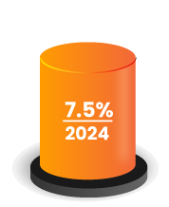
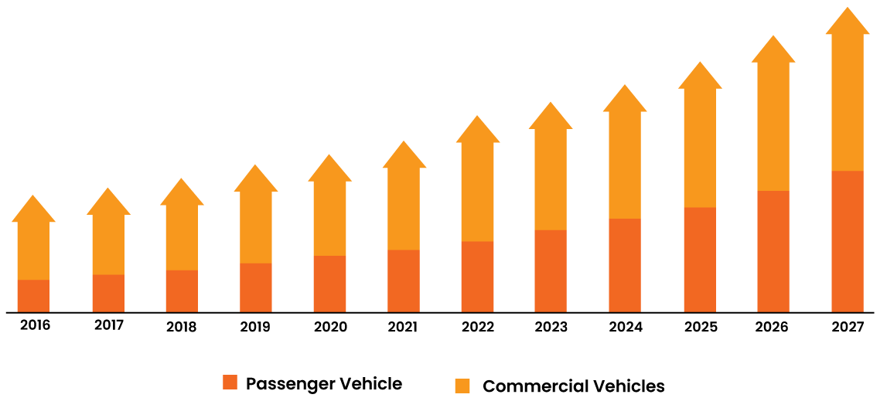
MARKET OPPORTUNITY
UAE Commercial Vehicle Telematics market size is projected to grow at a CAGR of 7.5 % by 2024.
The Logistics and Transportation industries are the key adopters of telematics system in UAE
Source: www.grandviewresearch.com

Slide 8
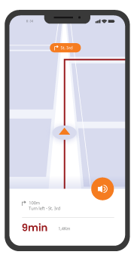
OUR SOFTWARE SOLUTION
Commercial Vehicle Tracking Management System
Passenger Vehicle Tracking Management System
Vehicle Tracking
Management system
Car Rental Management System
Delivery Dispatch Management System
School Transport Management System
Truck Booking & Dispatch
Management System
Corporate Transport Management System
Taxi Booking & Dispatch management System

Slide 9
OUR PRODUCT
24x7 Real Time Live Tracking
Route Optimization and Dispatching
Driver Behavior Analytics
Mobilizing & De Mobilizing
State of the art driver console
Multiple Mobile Applications
On Demand Reports
Vehicle Document Management
Echo Driving & Driver Ranking System
Live Client Support

Slide 10
WHY OPT OUR SERVICES
Artificial intelligence features
Saves more than it costs
Keep conflicts in check
Risk Management
Real time tracking
User roles according to your choice
Customization options
Low Maintenance
Reports for review
More ROI

Slide 11
OUR REVENUE
PROJECTION FOR 2021

Slide 12
Commercial Vehicle Management System
Sr. No. | Quarter | Description | Price (Per Vehicle per month) USD | Cumulative Total Number of Vehicles | Revenue $ | QuartelyRevenue $
1st Qtr | Jan to March | Vehicle Tracking Management System | 1 | 1000 | 3000 | 3600
Delivery Dispatch Management System | 1 | 100 | 300
Truck Booking & Dispatch Management system | 1 | 100 | 300
2nd Qtr | Apr to June | Vehicle Tracking Management System | 1 | 2000 | 6000 | 7200
Delivery Dispatch Management System | 1 | 200 | 600
Truck Booking & Dispatch Management system | 1 | 200 | 600
3rd Qtr | July to Sep | Vehicle Tracking Management System | 1 | 3000 | 9000 | 10800
Delivery Dispatch Management System | 1 | 300 | 900
Truck Booking & Dispatch Management system | 1 | 300 | 900
4th Qtr | Oct to Dec | Vehicle Tracking Management System | 1 | 4000 | 12000 | 15000
Delivery Dispatch Management System | 1 | 500 | 1500
Truck Booking & Dispatch Management system | 1 | 500 | 1500
 | Total |  |  |  | 36600

Slide 13
Passenger Vehicle Management System
Sr. No. | Quarter | Description | Price (Per Vehicle per month) USD | Cumulative Total Number of Vehicles | Revenue $ | QuartelyRevenue $
1st Qtr | Jan to March | Car Rental Management System | 3 | 50 | 450 | 2250
 |  | School Transportation Management System | 3 | 100 | 900
Cooperate Transport Management System | 3 | 50 | 450
Taxi Booking & Dispatch Management System | 3 | 50 | 450
2nd Qtr | Apr to June | Car Rental Management System | 3 | 100 | 900 | 4500
School Transportation Management System | 3 | 200 | 1800
Cooperate Transport Management System | 3 | 100 | 900
Taxi Booking & Dispatch Management System | 3 | 100 | 900
3rd Qtr | July to Sep | Car Rental Management System | 3 | 150 | 1350 | 6750
School Transportation Management System | 3 | 300 | 2700
Cooperate Transport Management System | 3 | 150 | 1350
Taxi Booking & Dispatch Management System | 3 | 150 | 1350
4th Qtr | Oct to Dec | Car Rental Management System | 3 | 200 | 1800 | 9000
School Transportation Management System | 3 | 400 | 3600
Cooperate Transport Management System | 3 | 200 | 1800
Taxi Booking & Dispatch Management System | 3 | 200 | 1800
 | Total |  |  |  | 22500

Slide 14
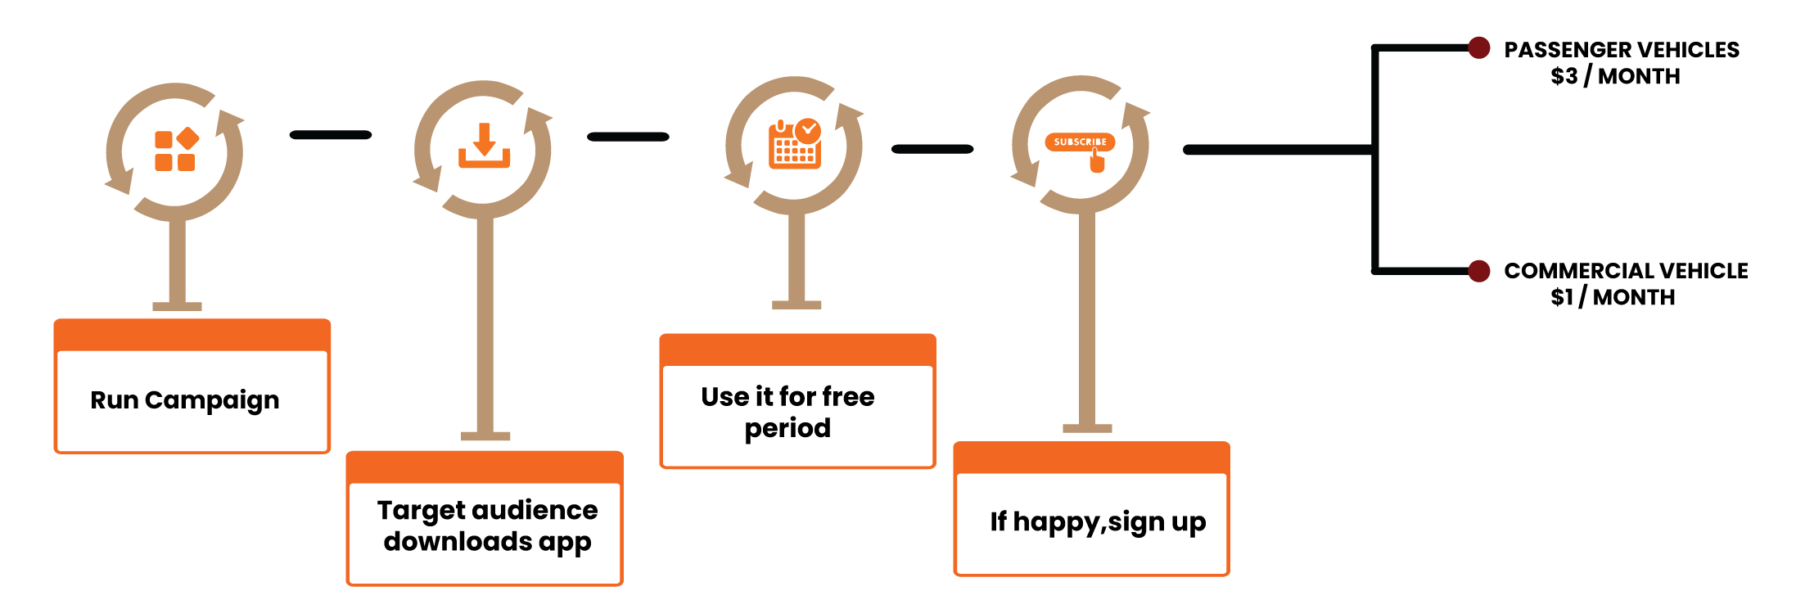
OUR BUSINESS MODEL

Slide 15
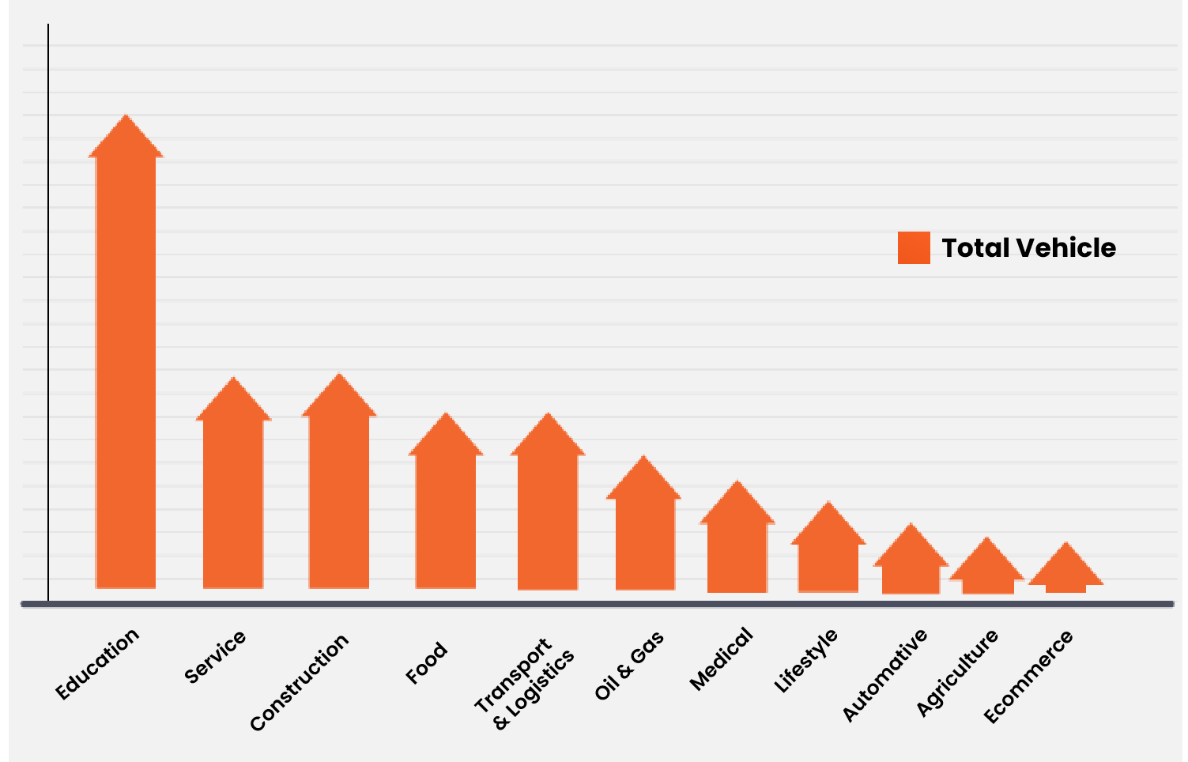
Our Client Base

Slide 16
2021 Predictions
We intent to provide tracking service to 5000 Commercial vehicles & 1000 Passengers by the end of 2021
UAE Commercial Vehicle Telematics market is projected to grow at a CAGR of 7.5 % by 2021 and with our target of 5000 commercial vehicles investors can get more in ROI
2022 Predictions
By 2022 we will increase our overall cost by 10% & reduce 15%-25% by means of Cost Optimization (Supplier Cost)
This cost projection will in turn bring a 25% hike in ROI, which will then be proportionally divided among Vehicle Tracking and investors.
For local partners, anything they charge above the distributor price (our price) is their ROI
Till date we have invested half a million dollars (500 K USD) on our product portfolio .

Slide 17
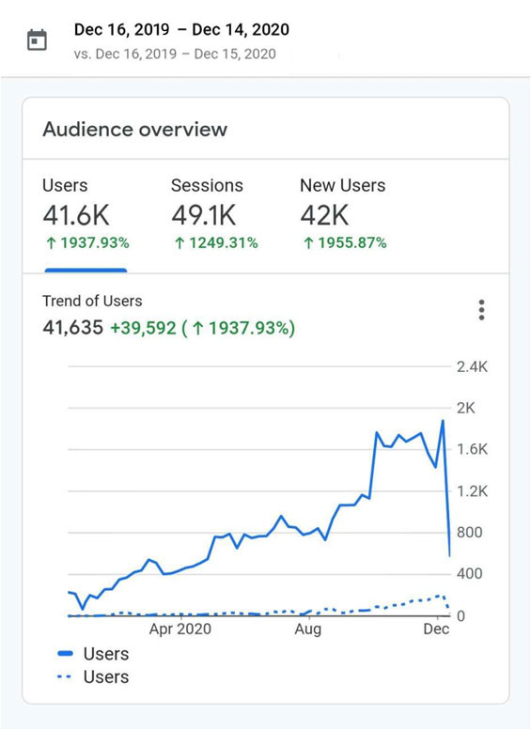
BUDGET NEEDED TO ACHIEVE THE FORECAST
REVENUE TARGET
Marketing budget 12,000 USD
Average cost per vehicle onboarding 4 USD
[Freemium services will be two months for commercial
vehicles and one month for Passenger vehicles]
Local sales personnel cost / expense 2000 USD
Demo and offshore support costs 3000 USD
Brochures/ Gifts/ etc. 1000 USD
The Digital Marketing Advantage
One of the best sites (ii) Fast Growing Website Traffic (see pic)
(iii) Monthly Leads Average around 30

Slide 18
COMPETITION
Our Key Competitors in the Vehicle Tracking System Market in UAE
What Differentiates us from Competitors
Transparent pricing & cost
calculation methods
Locator
Mygps
Dedicated app for each user role
Starlin Track
Fams
State of the art Passive tracking
technology
GeoLoc Star
Linxio
Real Time reports on different
demographics of the vehicle
Location solutions
Falcon
Al backed tracking methodologies

Slide 19
COMPETITOR FEATURE COMPARISON
Features | Mobitrack | ATS Qatar | adax | iprotek | Drofftech Solutions | qmic
Domain Specialised Offering
Vehicle Tracking system | ✓ | ✓ | ✓ | ✓ | ✓ | ✓
School Tranport | ✗ | ✗ | ✗ | ✗ | ✗ | ✗
Corporate Transport | ✗ | ✗ | ✗ | ✗ | ✗ | ✗
Waste Management Tranport | ✓ | ✗ | ✗ | ✗ | ✗ | ✗
Car Rental Management | ✗ | ✗ | ✗ | ✗ | ✗ | ✗
Artificial Intelligence
AI Routing Management | ✗ | ✗ | ✗ | ✗ | ✗ | ✗
AI Resource Optimisation | ✗ | ✗ | ✗ | ✗ | ✗ | ✗
Dispatch Management | ✗ | ✗ | ✗ | ✗ | ✗ | ✗
Driver Behaviour | ✗ | ✗ | ✗ | ✗ | ✗ | ✗
Live Tracking
Real Time Tracking | ✓ | ✓ | ✓ | ✓ | ✓ | ✓
Offline Tracking | ✗ | ✗ | ✗ | ✗ | ✗ | ✗

Slide 20
Management Modules
Vehicle Mangement | ✓ | ✓ | ✓ | ✓ | ✓ | ✗
User Management | ✓ | ✗ | ✓ | ✓ | ✓ | ✗
Video Surveillance | ✗ | ✗ | ✓ | ✗ | ✓ | ✗
Area Surveillance
Vehicle Geofencing | ✗ | ✗ | ✗ | ✗ | ✗ | ✗
Area Geofencing | ✓ | ✓ | ✗ | ✓ | ✓ | ✓
Parking Management | ✗ | ✗ | ✗ | ✗ | ✓ | ✗
Mobile Apps
Transport Manager | ✓ | ✗ | ✗ | ✗ | ✗ | ✓
Driver | ✗ | ✗ | ✗ | ✗ | ✗ | ✗
Mobile App Based Tracking | ✗ | ✗ | ✗ | ✗ | ✗ | ✗
Web Apps
Web Logic for Customer | ✓ | ✓ | ✓ | ✗ | ✗ | ✓
SAAS - Provision for Distributor | ✗ | ✗ | ✗ | ✗ | ✗ | ✗
SAAS Provision for Franchise | ✗ | ✗ | ✗ | ✗ | ✗ | ✗
Multi language Support | ✗ | ✗ | ✗ | ✗ | ✗ | ✗

Slide 21
CONTACT US
sales@fleetmanagement.ae
www.fleetmanagement.ae
+971 54 356 5369

Slide 22
THANK YOU

